Slide 1
EDINA Labs
A practical introduction to Python
EDINA 4/5/2016

Slide 2
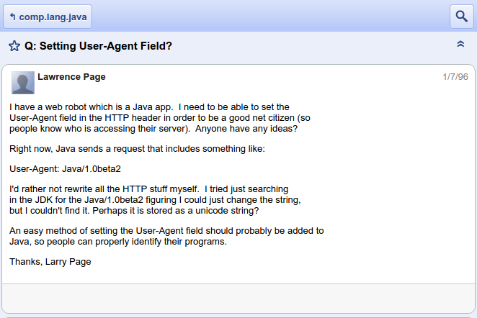
A practical introduction to Python

Slide 3
Getting started
You will already have Python 2.7 in your Linux distro
To avoid the mess, we will use a Virtual Environment
(Ubuntu):
  you@host:~$ sudo apt-get install python-virtualenv
  you@host:~$ virtualenv ve
  you@host:~$ . ve/bin/activate
  (ve)you@host:~$ pip install --upgrade pip
  (ve)you@host:~$ pip install ipython
  (ve)you@host:~$ ipython

Slide 4
Syntax
Will appear a bit alien to C-type-language connoisseurs
Indentation MATTERS and needs to be consistent
Some getting used to:
  Single-line comments are #<comment>
  Multiline comments are contained in “““<comment>”””
  <var>++ does not work, do <var> += 1

Slide 5
Typing
Python is:
  Strongly typed
    Interpreter tracks type of each variable
  Dynamically typed
    Type determined at runtime
  Implicitly typed
    Variables don't have to be declared

Slide 6
Basic types
Tuples
  1D immutable arrays
  tuple = (1, 2, 3)
Lists
  1D arrays (you can have lists of lists)
  list = [1, 2, 3]
Dictionaries (dicts)
  Hashtables (key/value)
  dict = {“key1”: 1, “key2”: 2, “key3”: 3}

Slide 7
Code organisation
Modules
  A module is a .py file containing definitions and statements
  Its name is available as __name__
  You can import it in code:
    import <module>
    or from <module> import <function>
  You can execute modules as scripts with:
    python <module>.py <arguments>
  By adding this you can use the file both as an importable module and an executable script:
    if __name__ == "__main__":
    import sys
    fib(int(sys.argv[1]))

Slide 8
Tutorial
https://www.stavros.io/tutorials/python/

